Slide 1
Comparative Analysis of Intel HLS Design Tools on a Case Study in Neuromorphic Machine Learning
Dr. Alan George
Mickle Chair Professor of ECE
University of Pittsburgh
Dr. Ryad Benosman
Professor of ECE and Ophthalmology
University of Pittsburgh
Luke Kljucaric
Predoctoral Fellow
University of Pittsburgh

Slide 2
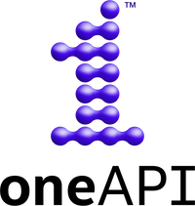

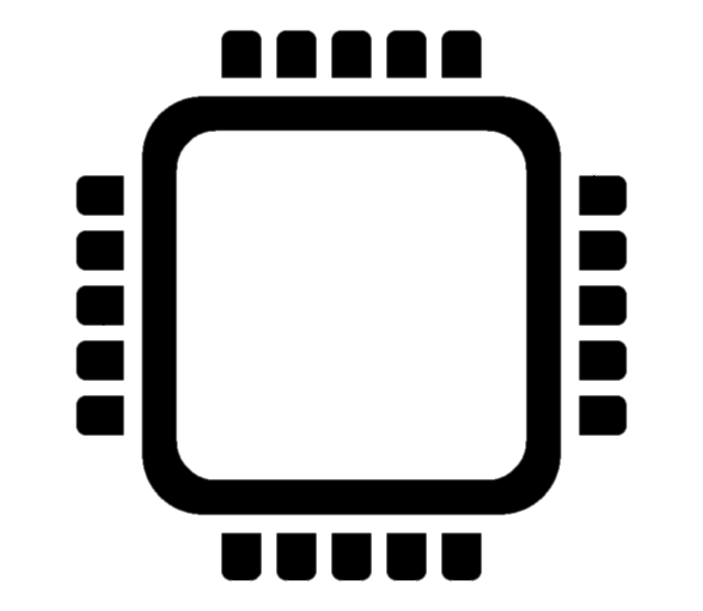


Overview
STP-H6-SSIVP Experiment on ISS
What is SHREC?
Background
  HLS Technologies
  Neuromorphic Technologies
Motivations
Approach
Results
  Performance
  Resource Usage
Conclusions

Slide 3


What is SHREC?
NSF Center for Space, High-Performance, & Resilient Computing
  Founded in Sep. 2017, replacing highly successful NSF CHREC Center
  Leading ECE research groups @ four major universities
    University of Pittsburgh (lead)
    Brigham Young University (partner)
    University of Florida (partner)
    Virginia Tech (partner)
Under auspices of IUCRC Program at NSF
  Industry-University Cooperative Research Centers
    Fostering university, agency, and industry R&D collaborations
  SHREC is both National Research Center and Consortium
    University groups serve as research base (faculty, students, staff)
    Industry & government organizations are research partners, sponsors, collaborators, advisory board, & technology-transfer recipients

Slide 4
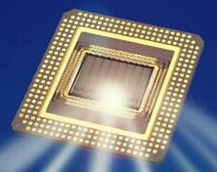

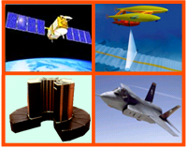
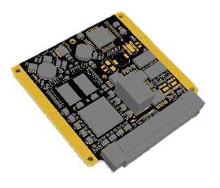
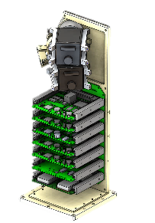
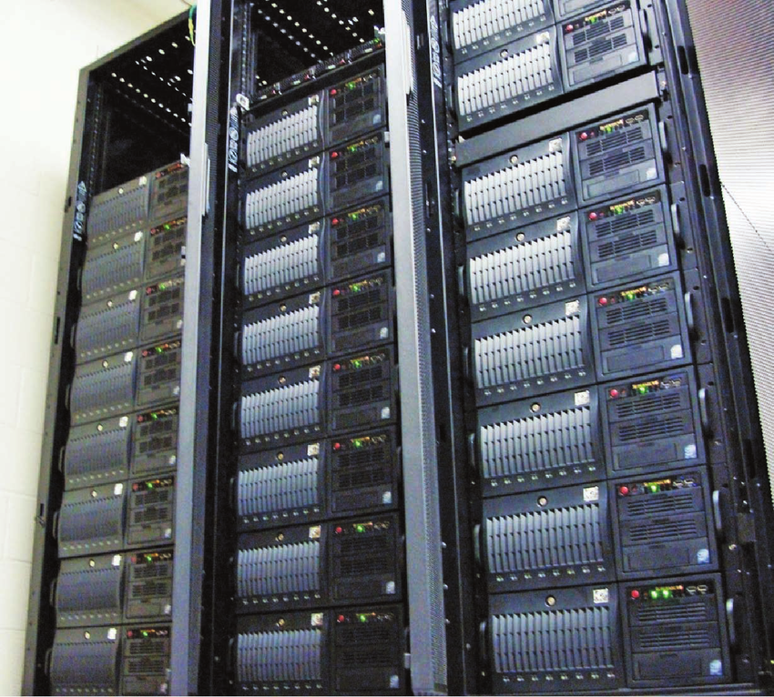
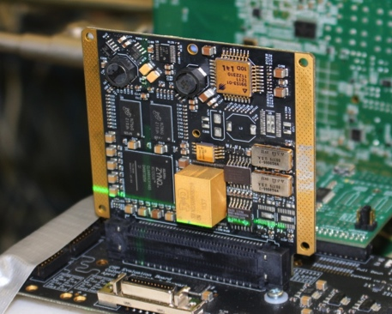
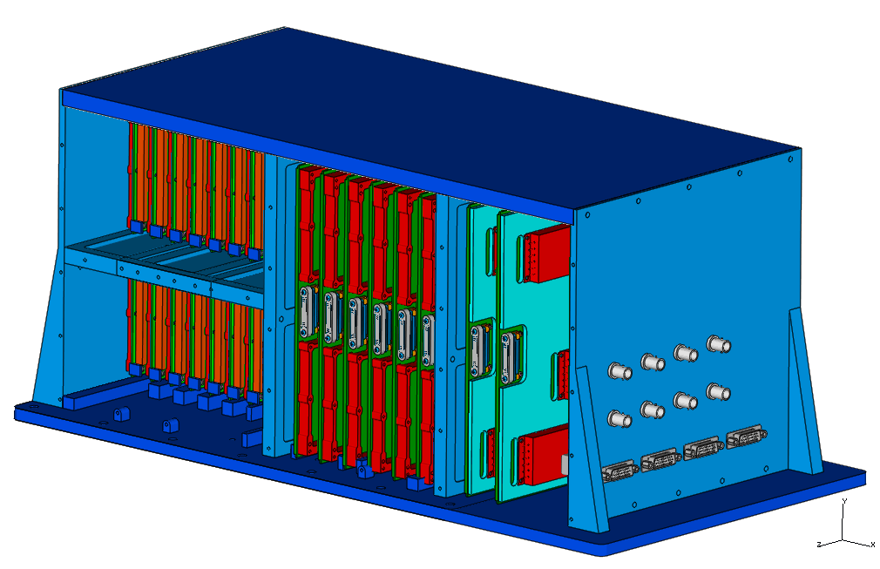
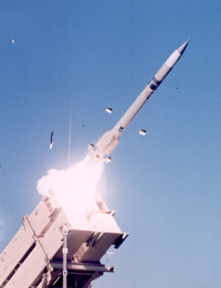
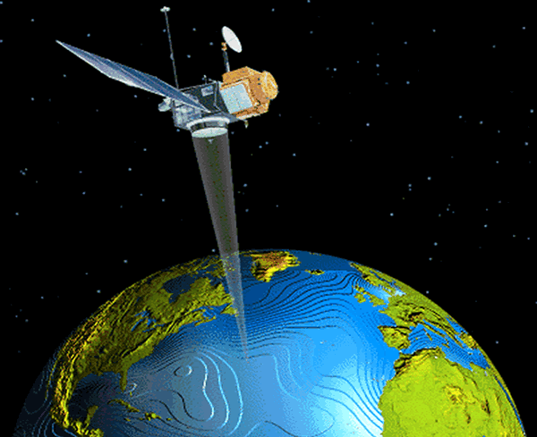
Center Mission
Theme: Mission-Critical Computing
Basic and applied R&D to advance
S&T on advanced computing.
Many common challenges, technologies, & benefits, in terms of performance, power, adaptivity, productivity, cost, size, etc.
From architectures to applications
to design concepts and tools.
From spacecraft to supercomputers!
Space
Computing
SHREC
High-Performance Computing
Resilient Computing

Slide 5
Research Interaction
NSF Model for IUCRC Centers
Industry & Government
Universities
Center
Basic Research
Applied R&D

Slide 6
CY20 Center Members
AFRL Sensors Directorate
AFRL Space Vehicles Directorate
AMD*
Army Research Laboratory
Astrobotic*
BAE Systems
Ball Aerospace
Blue Origin*
Capital One*
Columbus Technologies*
Dell EMC
Emergent Space Technologies
Fermilab
Genesis Engineering Solutions*
GSI Technology*
Honeywell
JPL*
L3Harris
Laboratory for Physical Sciences
Lockheed Martin
MIT Lincoln Laboratory
NASA Ames Research Center
NASA Goddard Space Flight Center
NASA IV&V Facility
NASA Johnson Space Center
National Reconnaissance Office
National Security Agency
Naval Research Laboratory
Raytheon
Sandia National Laboratories
Satlantis
Space Micro
Tiger Innovations*
* = 9 New Members in 2020

Slide 7
OpenCL For FPGAs
Describes host + accelerator model
  Host – CPU based, often C++
    Configures buffers (data transferred to/from FPGA)
      Abstracts DMA/memory subsystems
    Launches kernels (FPGA processing element)
      Multiple concurrent kernels
    Can perform work concurrently (inherent heterogeneous design)
  Accelerator
    Open Compute Language (OpenCL)
      Provides convenient access to more abstract data structures, functionality, control, etc. not typical on CPUs
      FPGAs often only fully support OpenCL v1.0 (limited)

Slide 8

oneAPI For FPGAs
Intel Single-Source Programming Model
  Host – CPU based, (Data-Parallel) DPC++
    Similar to OpenCL-based apps
    Kernel (accelerator) code expressed inline
    Unified shared memory
    Large set of library APIs to efficiently leverage accelerator devices
  Accelerator – DPC++
    DPC++ – C++ and SYCL
      Another abstraction layer on top of OpenCL
      Single-source programming model versus OpenCL kernels

Slide 9


Neuromorphic Technology
Asynchronous event-based vision sensors
  Mimic human-eye functionality
    Records individual changes in relative pixel luminance
  Data sent as stream of events
    Does not capture frames like conventional camera sensors
  Events captured at 1 µs resolution
    State of every pixel is known at each event
    Small number of events in real-world apps
    1M FPS effective frame rate
    Efficient data rate

Slide 10
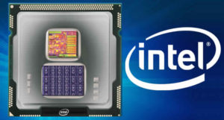

Neuromorphic Technology
Neuromorphic Architectures
  Mimic human-brain functionality
    Operates on spikes with many interconnected neurons
    Temporal- and rate-encoding provides more information
  Well suited for apps using neuromorphic sensors
    Event-based data carries “spikes” with time
  Intel Labs Loihi Architecture
Algorithms
  How do we classify objects?
  Reconstruct frames over time?
    Use CNNs?

Slide 11
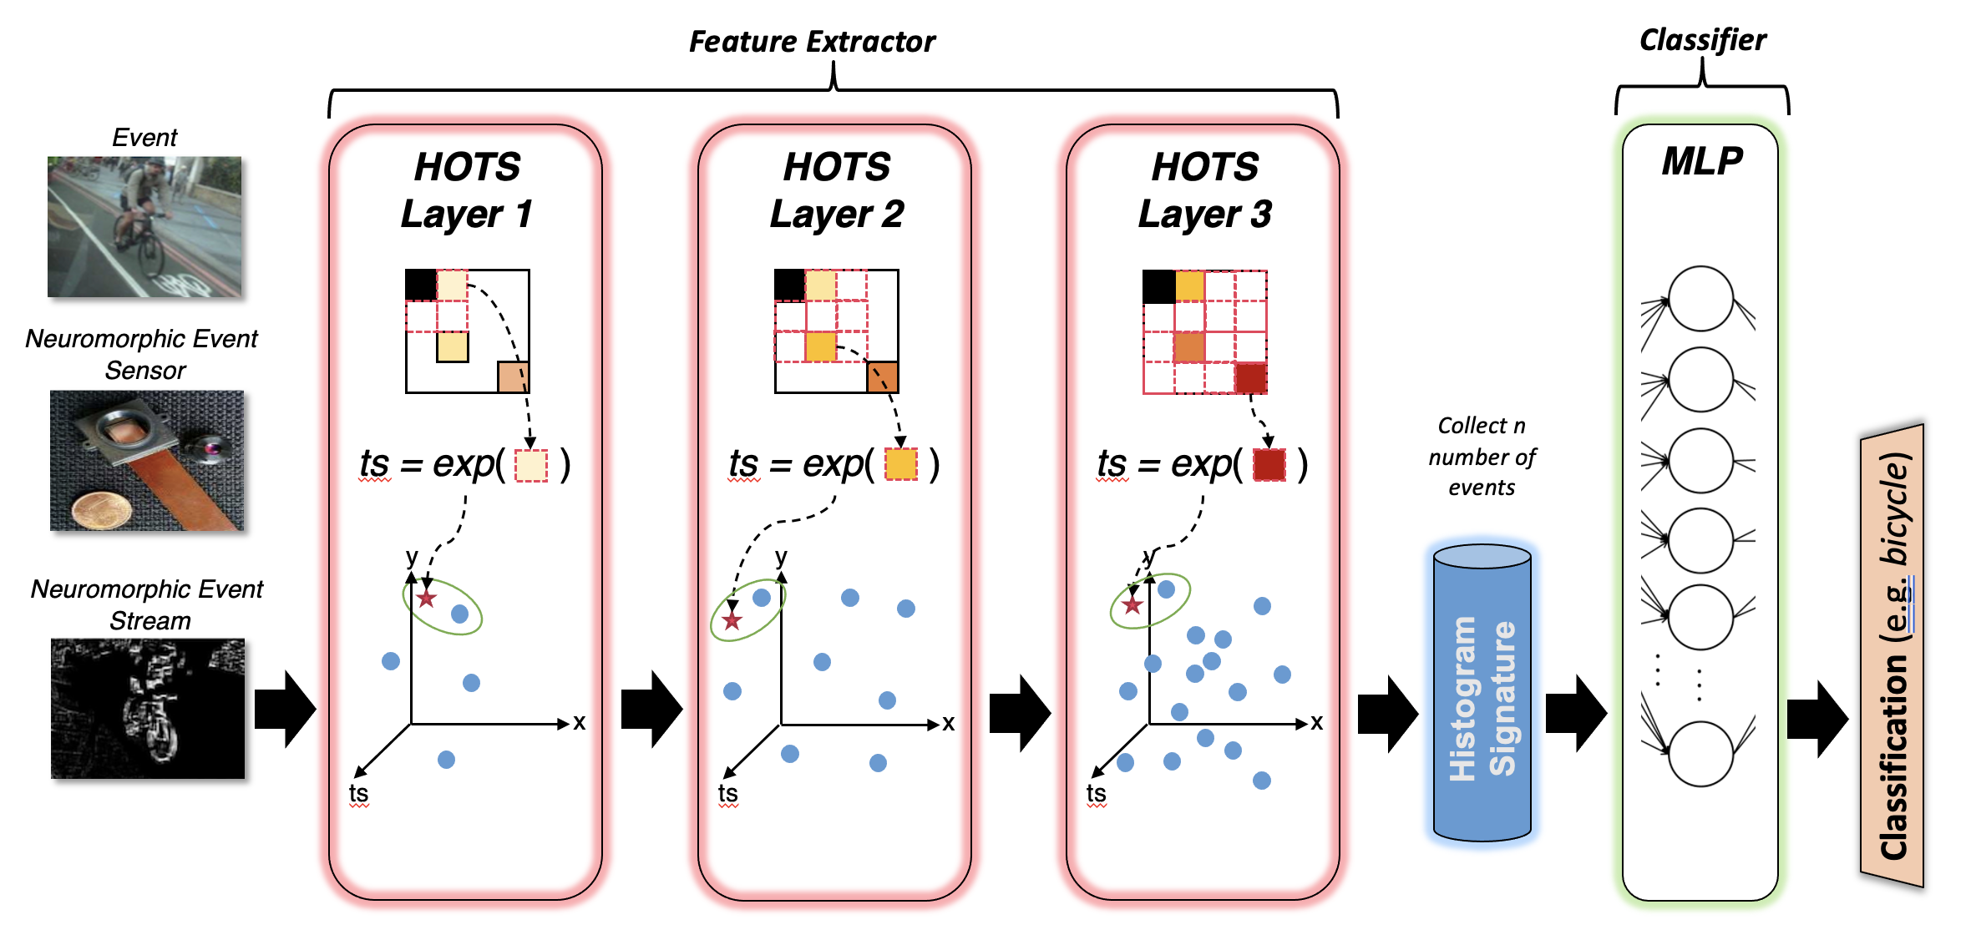
HOTS
A Hierarchy Of event-based Time Surfaces
  Relates spatial and temporal information
    Extracts object features for classification

Slide 12

Approach
Goals
Create high-performance, scalable FPGA designs for HOTS algorithm
Leverage heterogeneous computing resources for accelerated processing
Challenges
Neuromorphic sensors require sub-microsecond processing latency
Tradeoffs between compact designs for scalability and parallel performance
Optimize
Optimize single-kernel FPGA designs
Maximize parallel processing and limit resource usage
Investigate
Investigate tradeoffs of accelerating MLP classifier with GPUs
Explore multi-kernel designs for real-time FPGA performance
Evaluate
Evaluate state-of-the-art FPGA development tools and devices
Analyze performance vs. accuracy scaling
HOTS: A Hierarchy Of event-based Time-Surfaces
MLP: multilayer perceptron

Slide 13

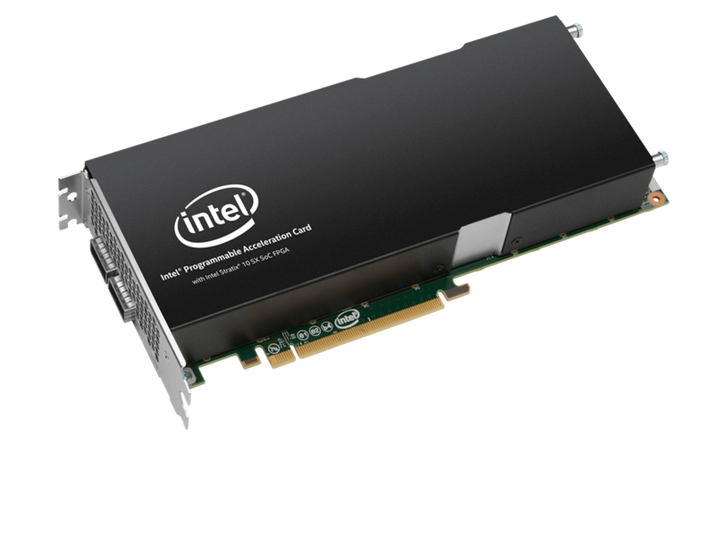
Approach
Intel DevCloud
Intel FPGA SDK for OpenCL™ v19.2
Intel oneAPI DPC++ Compiler v2021.2
aoc
aoc

Slide 14
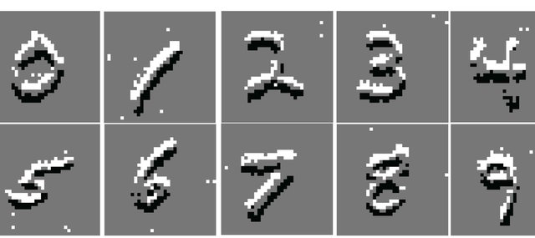
Approach
Datasets
  N-MNIST – Neuromorphic 1-to-1 MNIST
  N-Traffic – Custom traffic-based dataset
    Created with dynamic vision sensor for real-world data
Classifiers
  Histogram – How close features match class signature
  Multi-layer perceptron – higher accuracy
FPGA specifics
  Events-per-stream (EPS)
    Larger yields increased accuracy, smaller yields lower latency
  Designs use 100 EPS (~87% MLP accuracy)

Slide 15

High-Level Design
HLS tools need to convert software description into hardware description
  Have someone build a tower based on how it looks
    Build outside first then add floors separately?
    Start with the ground floor then add subsequent layers?
    Build different sections simultaneously and add together?
  Each method will result in designs with same functional output
    Each tower will look the same in our example
    How long it took to get there, resources used to finish the design, how efficient/sturdy the building is will vary

Slide 16
High-Level Design
Loop-based approach (most abstract)
Loop-Based Design
EVPS Stream Buffer
DDR
Kernel
Layer 1
Layer 2
Loop Based
Layer 3
DDR
Final Histogram (features)
*Closest representation to software (let the tools figure it out)

Slide 17
High-Level Design
Verbose single-kernel design
EVPS Stream Buffer
DDR
Kernel
Layer 1
Layer 2
Layer 3
DDR
Final Histogram (features)
*Monolithic kernel makes data transfer between layers simple, forces specific HW architecture. Layer 1 (smaller) is limited in performance by Layer 3

Slide 18
High-Level Design
Multi-kernel design
EVPS Stream Buffer
DDR
FPGA
Kernel 1
Kernel 2
Kernel 3
Pipe
Pipe
DDR
Final Histogram (features)
*Kernels running independently increases throughput, makes place-and-route (PAR) more difficult

Slide 19
High-Level Design
Intel PAC Arria 10
*result subject to further investigation with Intel (undetermined if profiling issue or lack of maturity)
More efficient SYCL-based exp function enables real-time performance
Real-time Performance Target – 1.00

Slide 20
High-Level Design
Intel PAC Arria 10
High OpenCL overhead even with arbitrary-precision variables
(12-bit int)
Significant reductions in state and control logic

Slide 21
High-Level Design
Intel PAC Stratix 10
*result subject to further investigation with Intel (undetermined if profiling issue or lack of maturity)
Both technologies achieve real-time performance
Real-time Performance Target – 1.00

Slide 22
High-Level Design
Intel PAC Stratix 10
2× reduction in private variables and state
SYCL back-end function 10× reduction in resources

Slide 23
Discussion
Performance
  Verbose hardware description yields better performance at the cost of more resources
    Kernel independence in pipe-based designs does not overcome communication overhead
  oneAPI designs average 20.3% lower latency
    Excludes pipe-based designs
    Achieves real-time processing on both Arria 10 and Stratix 10
    Less-complex logic, ~12% higher clock frequencies
  Newer Stratix 10 devices enables faster performance
    14nm vs 20nm, ~14% higher clock frequencies

Slide 24
Discussion
Hardware Resources
  Verbose- and pipe-based designs use ~2× more resources than loop-based designs
    Extra hardware for increased parallelism
  oneAPI-based designs use on average 3.8× less resources than OpenCL-based design
    Efficient SYCL function implementation
    Optimizations in control logic, state variables, and pipelining
  Lower percentage of resource used on Stratix 10 versus Arria 10
    Stratix 10 device contains ~2× more resources than Arria 10

Slide 25

oneAPI Case Study Conclusions
Lower-latency performance
  20.3% faster than OpenCL
More compact designs
  3.8× less resources used versus OpenCL
More efficient implementation of functions via SYCL
  Less-complex logic, fewer resources, lower latency, higher clock frequency
Enables real-time neuromorphic event processing on both FPGA architectures
  Stratix designs use <5% of all available FPGA resources, making designs highly scalable

Slide 26
Future Work
Multi-layer perceptron acceleration
  Currently computed on host CPU
  Can leverage oneAPI for acceleration
  Investigate oneAPI for FPGA-to-GPU data transfer
HOTS optimizations
  Discretization of exponential calculation
    SYCL implementation is efficient
    Still remains on critical path

Slide 27
Acknowledgment
Intel FPGA DevCloud
  Jeffery Nigh and Larry Landis
    Resource access, debugging, guidance
NSF SHREC
  Michael Ing and Devon Callanan
    Collaboration
This research was supported by SHREC industry and agency members and by the IUCRC Program of the National Science Foundation under Grant No. CNS-1738783.

Slide 28
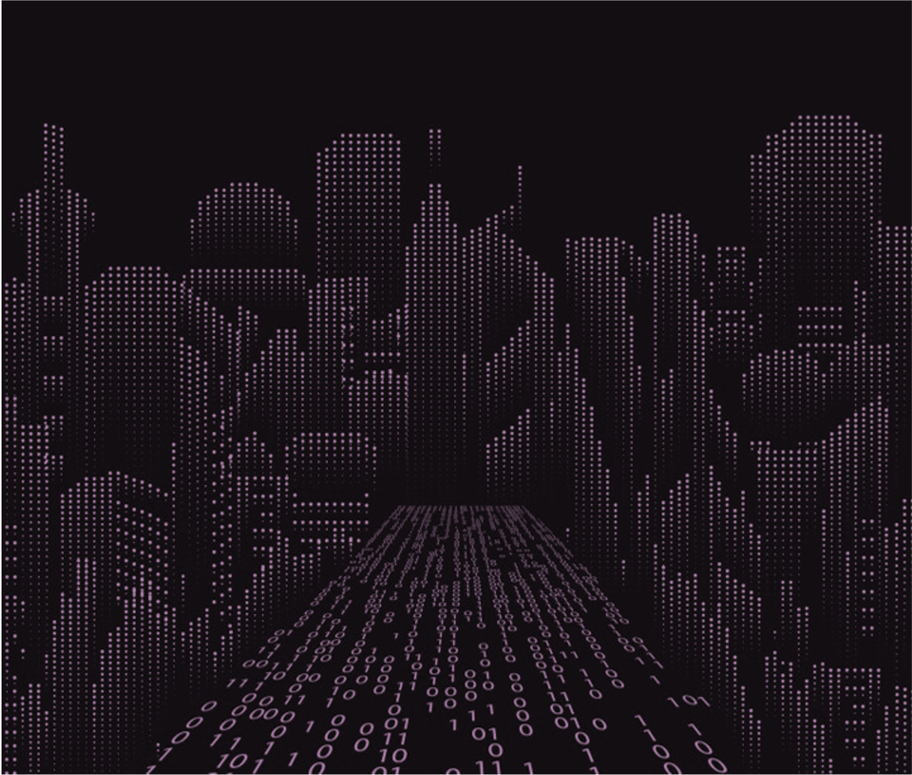
Questions?
Thanks for your attention!

Slide 29
References
[1] B. Jenkins, “Intel FPGA Design Workshop,” Intel Programmable Solu-tions Group. University of Pittsburgh Center for Research Computing.[Workshop on FPGA design using Intel Tools]. April 2019.
[2] L. Kljucaric, “Deep-Learning Inferencing with High-Performance Hard-ware Accelerators,” 2019 IEEE High Performance extreme ComputingConference (HPEC), Waltham, MA, 2019.
[3] X. Lagorce, G. Orchard, Et al., “HOTS : A Hierarchy Of event-basedTime-Surfaces for pattern recognition”, IEEE Trans. Pattern AnalysisMachine Intelligence, July 2016. doi :10.1109/TPAMI.2016.25747
[4] G. Martin, G. Smith, “High-level synthesis: Past, present, and future,”IEEE Design & Test of Computers, vol. 26, issue 4, pp. 18–25, August2009.
[5] F. Vahid, “Digital Design with RTL Design, Verilog and VHDL” (2nded.). John Wiley and Sons. p. 247. ISBN 978-0-470-53108-2. 2010.
[6] Intel Corporation, “oneAPI Specification,” Intel oneAPI Specification.2020. https://spec.oneapi.com/versions/latest/index.html
[7] J. Deng, W. Dong, Et al., ”ImageNet: A Large-Scale Hierarchical ImageDatabase,” CVPR09, 2009. http://image-net.org/about-publication
[8] J. Deng, W. Dong, Et al., ”ImageNet: A Large-Scale Hierarchical ImageDatabase,” CVPR09, 2009. http://image-net.org/about-stats
[9] S.-C. Liu, T. Delbruck, “Neuromorphic sensory systems,” Current Opin-ion in Neurobiology, vol. 20, issue 3, pp 288–295. June 2010.
[10] Y. Lecun, L. Bottou, Et al., “Gradient-based learning appliedto document recognition.” Proc. IEEE 86, 2278–2324. 1998. doi:10.1109/5.726791
[11] G. Orchard, G. Cohen, Et al., “Converting Static Image Datasets to Spik-ing Neuromorphic Datasets Using Saccades”, Frontiers in Neuroscience,vol.9, issue 437, Oct. 2015
[12] J. Lu, J. Dong, Et al., “An Event-based Categorization ModelUsing Spatio-temporal Features in a Spiking Neural Network,”2020 12th International Conference on Advanced ComputationalIntelligence(ICACI),Dali,China,2020,pp.385-390,doi:10.1109/ICACI49185.2020.9177628
[13] A. Sironi, M. Brambilla, Et al. “HATS: Histograms of Averaged TimeSurfaces for Robust Event-based Object Classification”. To appear inIEEE Conference on Computer Vision and Pattern Recognition (CVPR),2018. arXiv:1803.07913
[14] R. Ghosh, A. Mishra, Et. al, “Real-time object recognition and ori-entation estimation using an event-based camera and CNN,” 2014IEEE Biomedical Circuits and Systems Conference (BioCAS) Pro-ceedings, Lausanne, Switzerland, 2014, pp. 544-547, doi: 10.1109/Bio-CAS.2014.6981783
[15] M. Hofst ̈atter, M. Litzenberger, Et al., “Hardware-accelerated address-event processing for high-speed visual object recognition,” 2011 18thIEEE International Conference on Electronics, Circuits, and Systems,Beirut, Lebanon, 2011, pp. 89-92, doi: 10.1109/ICECS.2011.6122221.
[16] E. Luebbers, S. Liu, Et al., “Simplify Software Integration for FPGA Accelerators with OPAE” Intel FPGA White Paper. 2021.https://01.org/sites/default/files/downloads/opae/open-programmable-acceleration-engine-paper.pdf
[17] Intel Corporation , “Intel FPGA Programmable Acceleration Card D5005 Data Sheet” Intel Product Data Sheet. 2019. https://www.intel.com/content/www/us/en/programmable/products/boardsandkits/dev-kits/altera/intel-fpga-pac-d5005/documentation.html

