Slide 1
Developer Tools to Get You Started on oneAPI
Henry A Gabb
Senior Principal Engineer
Intel Architecture, Software, and Graphics

Slide 2
In a Data-Driven World, Acceleration Happens...
AI Training Cluster
Neural Network Processer
(Matrix)
Edge
Data Center
FPGA-Accelerated Filtering (Spatial)
Notebooks and Desktops
Multicore + SIMD CPUs, GPUs
(Scalar, Vector)
Sensor Array (400 GB/s)
HPC Center
Cloud Data Center
GPU Accelerated
(Vector)
Many applications, many computer architectures, many locations…

Slide 3
...And Many Diverse Programming Models
1,000,000s
1,000s
Abstract Programming Performance Implicit
General
Direct Programing
Performance Explicit
uArch Optimized
Node.js
Python
C/C++
FORTRAN
OpenMP
Parallel-For
SIMD
OpenMP Target
OpenACC
OpenCL
CUDA
Vector Intrinsics
GPU Intrinsics
Verilog
Problems?
Many languages and toolchains to train, deploy, and maintain
Performance-critical code is often specific to one uArch vendor
Performance-critical code often requires specialized developers
Enabling abstractions that deliver high-performance on diverse architectures

Slide 4
oneAPI Industry Initiative
Freedom to compute with XPUs
Open to promote community and industry collaboration
Enables code reuse across architectures and vendors
Application Workloads Need Diverse Hardware
Middleware & Frameworks
A cross-architecture language based on C++ and SYCL standards
Powerful libraries designed for acceleration of domain-specific functions
Low-level hardware abstraction layer
...
oneAPI Industry Specification
Direct Programming
API-Based Programming
Libraries
Math
Threading
DPC++ Library
Data Parallel C++
Analytics/ ML
DNN
ML Comm
Video Processing
Low-Level Hardware Interface
XPUs
The productive, smart path to freedom for accelerated computing from the economic and technical burdens of proprietary programming models
CPU
GPU
FPGA
Other Accel.

Slide 5
oneAPI Industry Initiative Progress
2019
2020
2021
Q1 | Q2 | Q3 | Q4
oneAPI Industry Initiative
oneAPI 1.0 Spec
more to come…
Initiative Announced
oneAPI 0.6 Spec
oneAPI 0.7 Spec
oneAPI 0.8 Spec
oneAPI 0.9 Spec
Lots of great conversations and input for a year.
And the conversations and input continue because oneAPI is open.

Slide 6
oneAPI Industry Initiative Progress
2019
2020
2021
Q1 | Q2 | Q3 | Q4
oneAPI Industry Initiative
oneAPI 1.0 Spec
more to come…
Initiative Announced
oneAPI 0.6 Spec
oneAPI 0.7 Spec
oneAPI 0.8 Spec
oneAPI 0.9 Spec
Univ Heidelberg to deliver oneAPI AMD GPU Support
oneAPI Industry Adoption
Codeplay oneAPI Nvidia GPU Support
Fugaku implements oneDNN for ARM

Slide 7
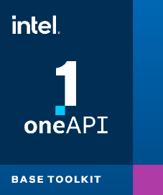
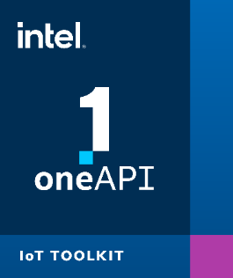
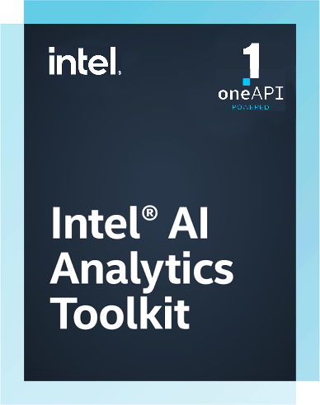
Intel® oneAPI Toolkits A Complete Set of Proven Developer Tools from CPU to XPU
Intel® oneAPI Base Toolkit
A core set of high-performance tools for building DPC++ and oneAPI library-based applications
Native Code Developers
Intel® oneAPI Rendering Toolkit
Intel® oneAPI Tools for HPC
Intel® oneAPI Tools for IoT
Add-on Domain-specific Toolkits
Deliver fast Fortran, OpenMP, and MPI applications
Build efficient, reliable solutions at the edge
Create performant, high-fidelity visualization applications
Specialized Workloads
Intel® AI Analytics Toolkit
Intel® Distribution of OpenVINO™ Toolkit
Accelerate ML/DL and data science pipelines with optimized frameworks and Python libraries
Deploy high-performance inference and applications from edge to cloud
Toolkit
Latest version is 2021.1

Slide 8
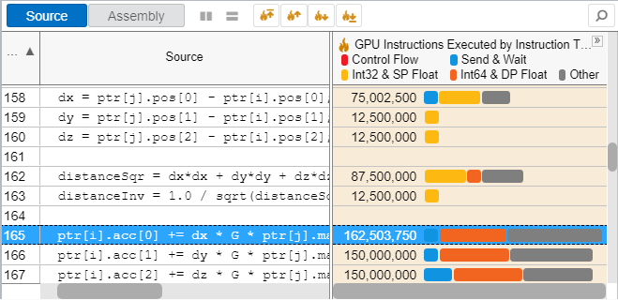
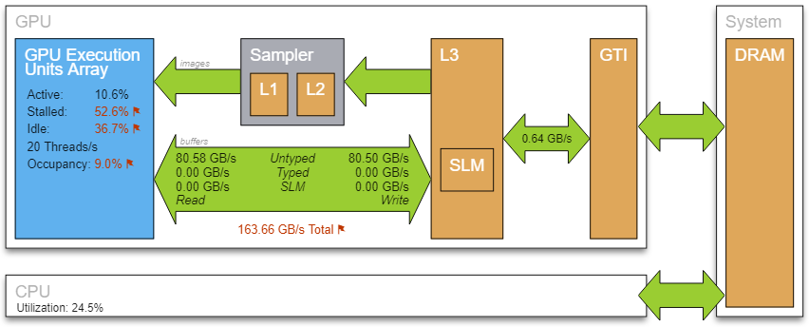
Intel® VTune™ Profiler DPC++ Profiling and Tuning for XPUs
Analyze Data Parallel C++ (DPC++)
See the lines of DPC++ that consume the most time
Tune for Intel CPUs, GPUs & FPGAs
Optimize for any supported hardware accelerator
Optimize Offload
Tune OpenMP offload performance
Wide Range of Performance Profiles
CPU, GPU, FPGA, threading, memory, cache, storage…
Supports Popular Languages
DPC++, C, C++, Fortran, Python, Go, Java, or a mix

Slide 9
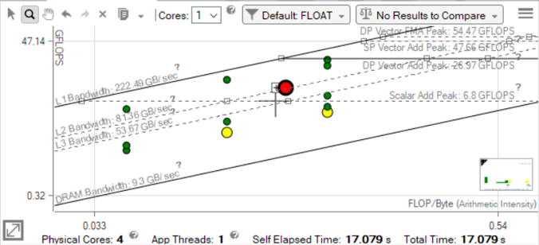
Intel® Advisor Design Assistant for Modern Hardware
Offload Advisor
Estimate benefit of offloading to an accelerator
Roofline Analysis
Optimize CPU/GPU code for memory and compute
Vectorization Advisor
Add and optimize vectorization
Threading Advisor
Advice on where to add multithreading
Flow Graph Analyzer
Create and analyze efficient flow graphs

Slide 10
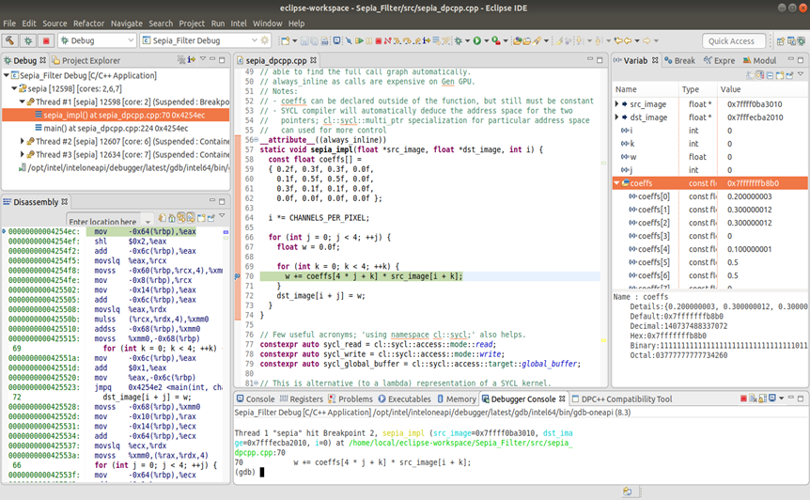
Intel® Distribution for GDB DPC++ Debugging for Cross-Architecture Applications
High-level language debugging support
Multiple accelerator support: Intel CPU, GPU, FPGA emulation
Auto-detect accelerator architecture at runtime
Non-proprietary open-source solution based on GDB

Slide 11
Intel® oneAPI Toolkits Free Availability
Run the tools locally
Run the tools in the cloud
Downloads
Get Started Quickly Code Samples, Quick Start Guides, Webinars, Training
https://software.intel.com/content/www/us/en/develop/tools/oneapi/base-toolkit.html
Repositories
DevCloud
Containers

Slide 12
Intel® DevCloud for oneAPI Free Access, A Fast Way to Start Coding
Learn Data Parallel C++
A development sandbox to develop, test, and run workloads across a range of Intel® CPUs, GPUs, and FPGAs using Intel’s oneAPI software
For customers focused on data-centric workloads on a variety of Intel® architectures
Use Intel® oneAPI Toolkits
Evaluate Workloads
Prototype Your Project
Build Cross-Architecture Applications
No Downloads | No Hardware Acquisition | No Installation | No Set-up & Configuration
Get Up & Running in Seconds!
software.intel.com/devcloud/oneapi

Slide 13
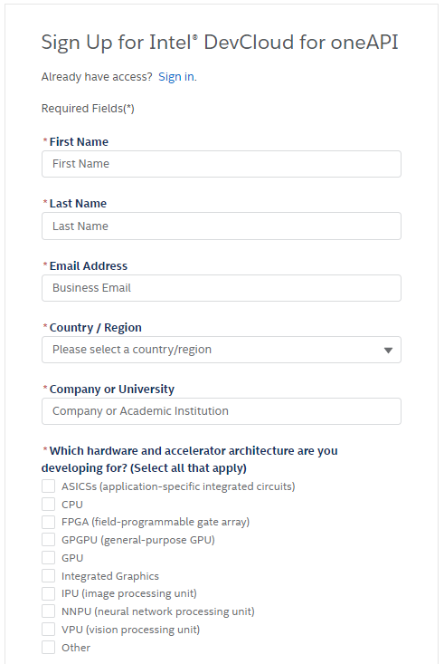
Getting Access
Sign-up is fast and easy
120-day access with possible extensions for active projects
Access to Intel CPUs, GPUs, FPGAs
New hardware accessible under NDA
Active support forums

Slide 14
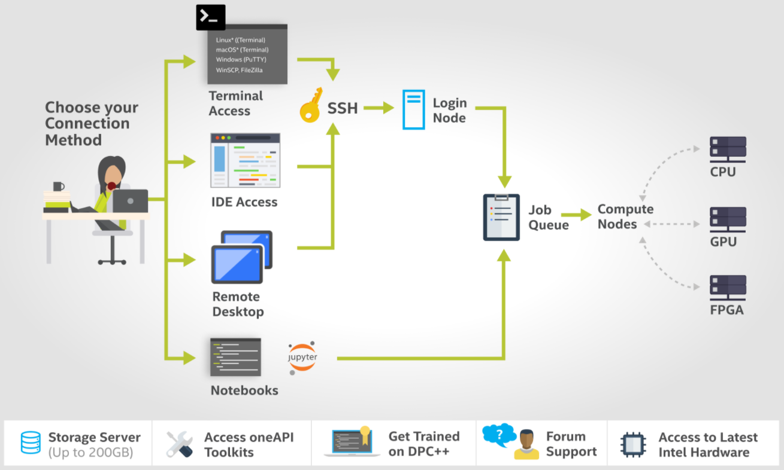

Slide 15
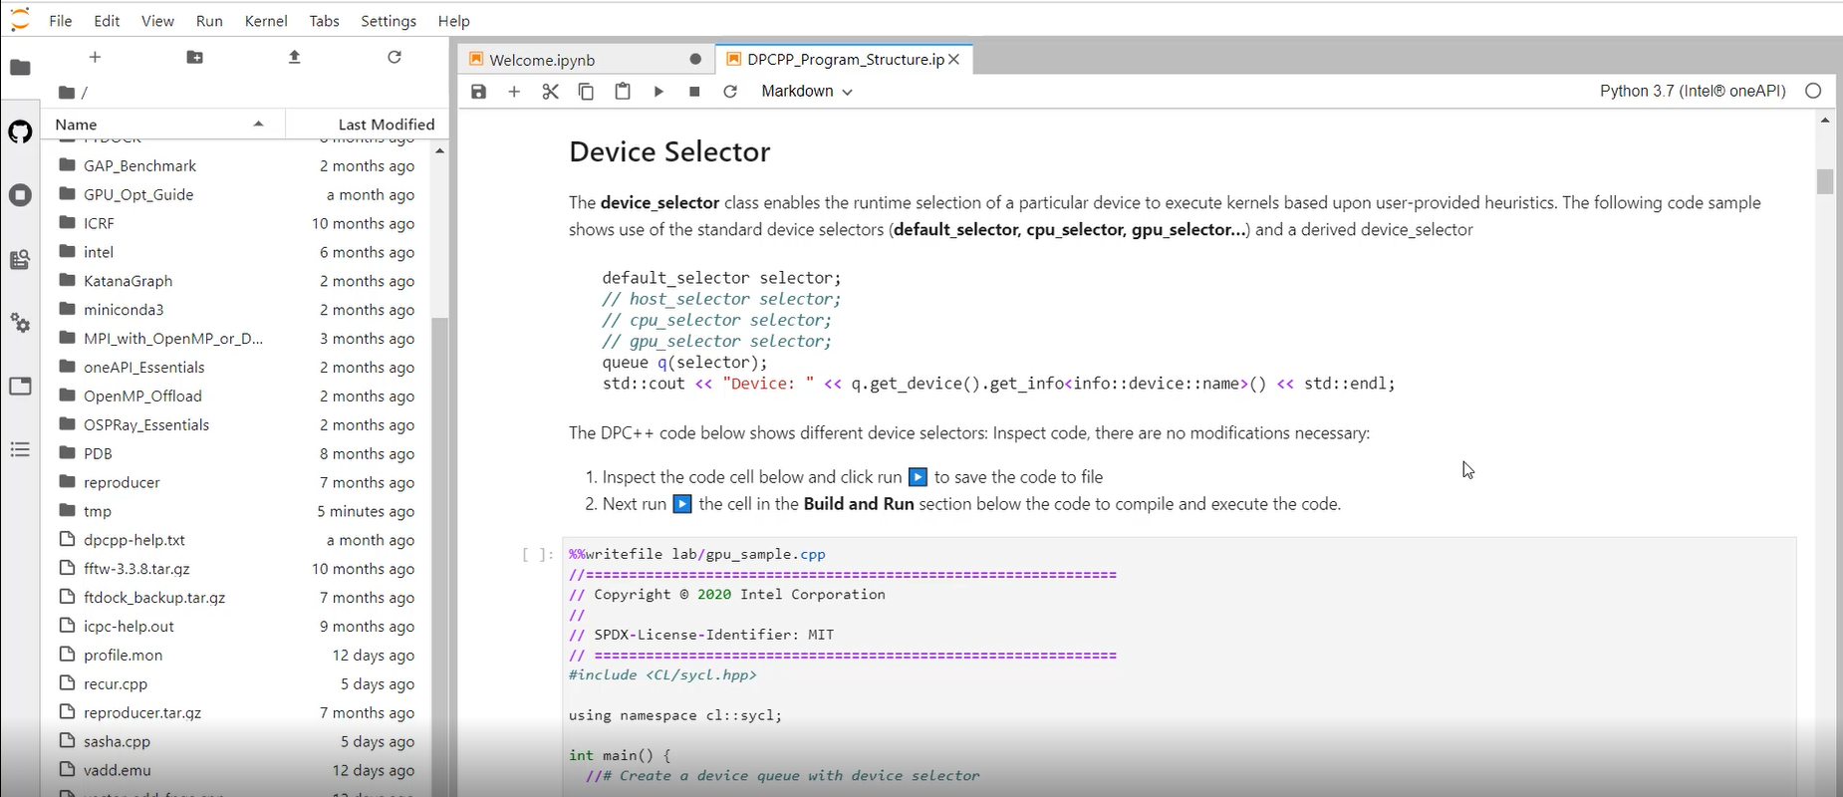

Slide 16
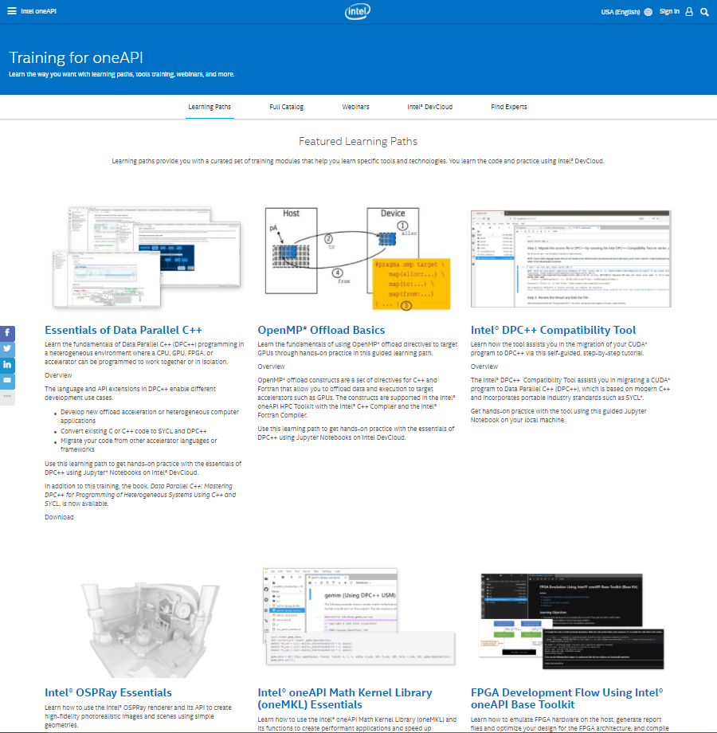
Getting Training
Extensive and growing library of training material
Content covers oneAPI components, Intel® DevCloud usage, etc.
Material includes code samples, webinars, technical guides, etc.
https://software.intel.com/content/www/us/en/develop/tools/oneapi/training.html

Slide 17
Call to Action
Develop cross-architecture parallel applications using oneAPI.
It’s open.
It’s easy.
It’s fun.
Experiment with the latest Intel XPUs and Intel® oneAPI Toolkits on the Intel® DevCloud for oneAPI.
It’s free.
It’s convenient.
It’s flexible.

Slide 18
oneCCL Specification
Thank You!
http://oneapi.com

